Slide 1
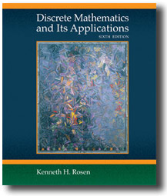

Chapter 5
Counting
Discrete Mathematics
and Its Applications
Sixth Edition
By Kenneth Rosen
歐亞書局

Slide 2
5.1 The Basics of Counting
5.2 The Pigeonhole Principle
5.3 Permutations and
Combinations
5.4 Binomial Permutations and
Combinations
5.5 Generalized Permutations and Combinations
5.6 Generating Permutations and
Combinations
歐亞書局
P. 335

Slide 3
5.1 The Basics of Counting
Basic Counting Principles
  The product rule: Suppose that a procedure can be broken down into a sequence of two tasks. If there are n1 ways to do the first task and for each of these ways, there are n2 ways to do the second task, then there are n1n2 ways to do the procedure

Slide 4
Example # 1
A new company with just two employees, Sanchez and Patel, rents a floor of a building with 12 offices. How many ways are there to assign different offices to these two employees?
The procedure of assigning offices to these two employees consists of assigning an office to Sanchez, which can be done in 12 ways.
Assigning an office to Patel different from the office assigned to Sanchez, which can be done in 11 ways.
By the product rule, there are 12 · 11 = 132 ways to assign offices to these two employees.

Slide 5
Example # 2
The chairs of an auditorium are to be labeled with an uppercase English letter followed by a
positive integer not exceeding 100. What is the largest number of chairs that can be labeled
differently?
The procedure of labeling a chair consists of two tasks, namely, assigning to the seat one of the 26 uppercase English letters, and then assigning to it one of the 100 possible integers.
The product rule shows that there are 26 · 100 = 2600 different ways that a chair can be labeled.
Therefore, the largest number of chairs that can be labeled differently is 2600.

Slide 6
Example # 3
There are 32 microcomputers in a computer center. Each microcomputer has 24 ports. How
many different ports to a microcomputer in the center are there?
The procedure of choosing a port consists of two tasks, first picking a microcomputer and then picking a port on this microcomputer. Because there are 32 ways to choose the microcomputer and 24 ways to choose the port no matter which microcomputer has been selected, the product rule shows that there are 32 · 24 = 768 ports.

Slide 7
Example # 4
How many different bit strings of length seven are there?
Each of the seven bits can be chosen in two ways, because each bit is either 0 or 1.
Therefore, the product rule shows there are a total of 27 = 128 different bit strings of length seven.

Slide 8
Example # 5
How many different license plates can be made if each plate contains a sequence of three uppercase English letters followed by three digits (and no sequences of letters are prohibited, even if they are obscene)?
There are 26 choices for each of the three uppercase English letters and ten choices for each of the three digits. Hence, by the product rule there are a total of 26 · 26 · 26 · 10 · 10 · 10 = 17,576,000 possible license plates.

Slide 9
5.1 The Basics of Counting
Basic Counting Principles
  The sum rule: If a task can be done either in one of n1 ways or in one of n2 ways, where none of the set of n1 ways is the same as any of the set of n2 ways, then there are n1+n2 ways to do the task
    Ex. 11-13

Slide 10
The product rule: If A₁,A₂ ,…,A_{m} are finite sets, then the number of elements in the Cartesian product of these sets is the product of the number of elements in each set.
  |A₁× A₂ × …× A_{m}|= |A₁||A₂| …|A_{m}|
The sum rule: If A₁,A₂ ,…,A_{m} are disjoint finite sets, then the number of elements in the union of these sets is the sum of the number of elements in each set.
  |A₁∪ A₂ ∪ … ∪ A_{m}|= |A₁|+|A₂|+ …+|A_{m}|

Slide 11
Example
Suppose that either a member of the mathematics faculty or a student who is a mathematics major is chosen as a representative to a university committee. How many different choices are there for this representative if there are 37 members of the mathematics faculty and 83 mathematics majors and no one is both a faculty member and a student?

Slide 12
Solution
There are 37 ways to choose a member of the mathematics faculty and there are 83 ways to choose a student who is a mathematics major.
Choosing a member of the mathematics faculty is never the same as choosing a student who is a mathematics major because no one is both a faculty member and a student.
By the sum rule it follows that there are 37 + 83 = 120 possible ways to pick this representative.

Slide 13
Example
A student can choose a computer project from one of three lists. The three lists contain 23, 15, and 19 possible projects, respectively.
No project is on more than one list. How many possible projects are there to choose from?

Slide 14
Solution
The student can choose a project by selecting a project from the first list, the second list, or the third list. Because no project is on more than one list, by the sum rule there are
23 + 15 + 19 = 57 ways to choose a project.

Slide 15
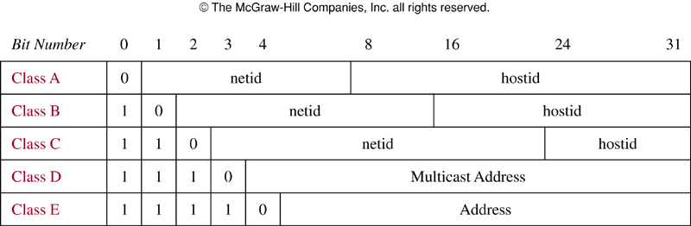
HomeWork
FIGURE 1 Internet Addresses (IPv4).
歐亞書局
P. 341
Notes:
p:\msoffice\My Projects\Rosen 6e 2007\Imagebank\JPEGs07-24-06\ch05\jpeg\05_1_01.jpg

Slide 16
The Inclusion-Exclusion Principle
Suppose a task can be done in n1 or n2 ways, but some of the set of n1 ways are the same as some of the n2 ways, we have to subtract the number of ways to do the task that is both among the set of n1 ways and the set of n2 ways
  The subtraction principle
  |A₁∪ A₂ |= |A₁|+|A₂|- |A₁∩ A₂ |

Slide 17
Example
How many bit strings of length eight either start with a 1 bit or end with the two bits 00?

Slide 18
Solution
Construct a bit string of length eight that begins with a 1 in 2⁷ = 128 ways.
Construct a bit string of length eight ending with the two bits 00, in 2⁶ = 64 ways.

Slide 19
Solution
Some of the ways to construct a bit string of length eight starting with a 1 are the same as the ways to construct a bit string of length eight that ends with the two bits 00.
There are 2⁵ = 32 ways to construct such a string.
The number of bit strings are
128 + 64 − 32 = 160.

Slide 20
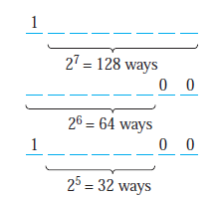
Solution

Slide 21
Tree Diagrams
Counting problems can be solved using tree diagrams
  Leaves: possible outcomes

Slide 22
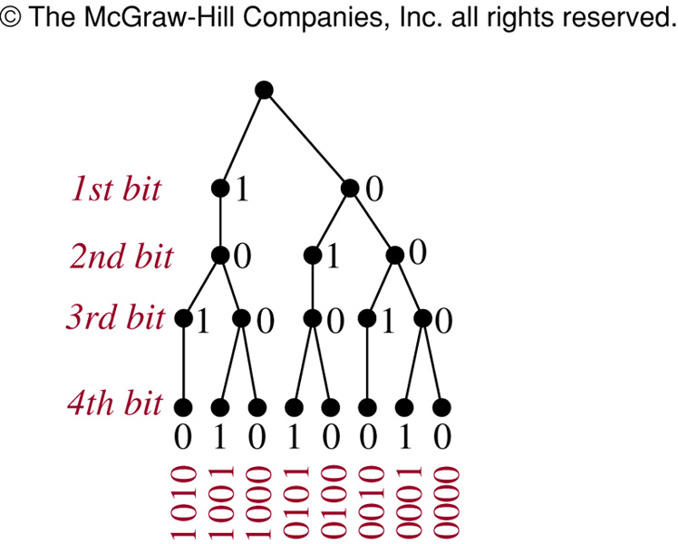
FIGURE 2 (5.1)
FIGURE 2 Bit Strings of Length Four without Consecutive 1s.
歐亞書局
P. 343
Notes:
p:\msoffice\My Projects\Rosen 6e 2007\Imagebank\JPEGs07-24-06\ch05\jpeg\05_1_02.jpg

Slide 23
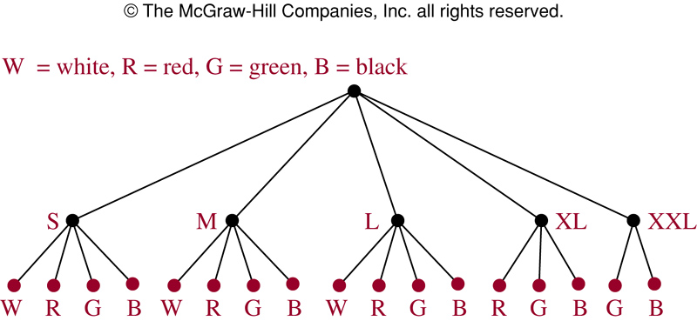
HomeWork
FIGURE 4 Counting Varieties of T-Shirts.
歐亞書局
P. 344
Notes:
p:\msoffice\My Projects\Rosen 6e 2007\Imagebank\JPEGs07-24-06\ch05\jpeg\05_1_04.jpg

Slide 24
5.2 The Pigeonhole Principle
If there are more pigeons than pigeonholes, then there must be at least one pigeonhole with at least two pigeons in it
Theorem 1: (The Pigeonhole Principle) If k is a positive integer and k+1 or more objects are placed into k boxes, then there is at least one box containing two or more of the objects.

Slide 25
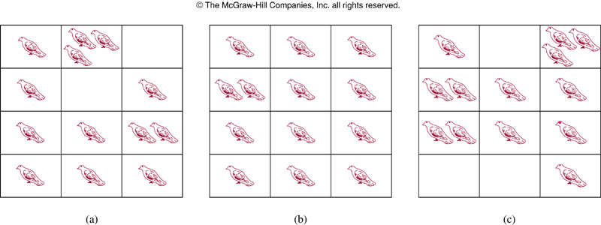
FIGURE 1 (5.2)
FIGURE 1 There Are More Pigeons Than Pigeonholes.
歐亞書局
P. 347
Notes:
p:\msoffice\My Projects\Rosen 6e 2007\Imagebank\JPEGs07-24-06\ch05\jpeg\05_2_01.jpg

Slide 26
Corollary 1: A function from a set with k+1 or more elements to a set with k elements is not one-to-one.

Slide 27
Example
Among any group of 367 people, there must be at least two with the same birthday, because there are only 366 possible birthdays.
In any group of 27 English words, there must be at least two that begin with the same letter, because there are 26 letters in the English alphabet.

Slide 28
Question
How many students must be in a class to guarantee that at least two students receive the same score on the final exam, if the exam is graded on a scale from 0 to 100 points?

Slide 29
The Generalized Pigeonhole Principle
Theorem 2: (The Generalized Pigeonhole Principle) If N objects are placed into k boxes, then there is at least one box containing at least ⎡N/k⎤ objects.

Slide 30

Example
Among 100 people there are at least
who were born in the same month.
What is the minimum number of students required in a discrete mathematics class to be sure that at least six will receive the same grade, if there are five possible grades, A, B, C, D, and F?

Slide 31
Example
The minimum number of students needed to ensure that at least six students receive the same grade is the smallest integer N such that N/5 = 6.
The smallest such integer is
N = 5 · 5 + 1 = 26.
If you have only 25 students, it is possible for there to be five who have received each grade so that no six students have received the same grade.

Slide 32
Example
Thus, 26 is the minimum number of students needed to ensure that at least six students will receive the same grade.

Slide 33
Example
A standard deck of 52 cards has 13 kinds of cards, with four cards of each of kind, one in each of the four suits, hearts, diamonds, spades, and Clubs.

Slide 34
Question
a) How many cards must be selected from a standard deck of 52 cards to guarantee that at least three cards of the same suit are chosen?
b) How many must be selected to guarantee that at least three hearts are selected?

Slide 35
Solution (a)
a) Suppose there are four boxes, one for each suit, and as cards are selected they are placed in the box reserved for cards of that suit.
Using the generalized pigeonhole principle, we see that if N cards are selected, there is at least one box containing at least ┌N/4┐ cards.

Slide 36
Solution (a)
Consequently, we know that at least three cards of one suit are selected if ┌ N/4 ┐ ≥ 3.
The smallest integer N such that
┌ N/4 ┐ ≥ 3 is N = 2 · 4 + 1 = 9, so nine cards suffice.
if eight cards are selected, it is possible to have two cards of each suit, so more than eight cards are needed.

Slide 37
Solution (a)
Consequently, nine cards must be selected to guarantee that at least three cards of one suit are chosen.
One good way to think about this is to note that after the eighth card is chosen, there is no way to avoid having a third card of some suit.

Slide 38
Solution (b)
42 cards to get three hearts.

Slide 39
Some Elegant Applications of the Pigeonhole Principle
Suppose a1, a2, …, aN is a sequence of real numbers, a subsequence of this sequence is a sequence of the form ai1, ai2, …aim, where 1<=i1<i2<…<im<=N

Slide 40
Theorem 3: Every sequence of n²+1 distinct real number contains a subsequence of length n+1 that is either strictly increasing or strictly decreasing.
  Ex.12
  Ramsey theory
    Ex.13
    Ramsey number R(m,n): the minimum number of people at a party such that there are either m mutual friends or n mutual enemies

Slide 41
5.3 Permutations and Combinations
Permutations
  A permutation of a set of distinct objects is an ordered arrangement of these objects
  r-permutation: an ordered arrangement of r elements of a set
  Ex.1
  Ex.2
  P(n,r): the number of r-permutations of a set with n elements

Slide 42
Theorem 1: If n is a positive integer and r is an integer with 1<=r<=n, then there are P(n,r)=n(n-1)(n-2)…(n-r+1) r-permutations of a set with n distinct elements.
  P(n,0)=1
  P(n,n)=n!
Corollary 1: If n and r are integers with 0<=r<=n, then P(n,r)=n!/(n-r)!
  Ex. 4-7

Slide 43

Combinations
  Finding the number of subsets of a particular size
  r-combination: an unordered selection of r elements from the set
  Ex.8-9
  C(n,r): the number of r-combinations of a set with n elements
    Also denoted by , and is called a binomial coefficient

Slide 44
Theorem 2: The number of r-combinations of a set with n elements, where n is a nonnegative integer and r is an integer with 0<=r<=n, equals
C(n,r)=n!/(r!(n-r)!)
  Proof
  C(n,r)=n(n-1)…(n-r+1)/r!
Corollary 2: Let n and r be nonnegative integers with r<=n. Then C(n,r)=C(n,n-r).
  Proof

Slide 45
Definition 1: A combinatorial proof of an identity: using counting arguments to prove that both sides of the identity count the same objects but in different ways.
  Ex.12-15

Slide 46
5.4 Binomial Coefficients
(x+y)^{n}
  Ex.1
Theorem 1: (The Binomial Theorem) Let x and y be variables, and let n be a nonnegative integer. Then,
(x+y)^{n}=Σ_{j=0..n} C(n,r)x^{n-j}y^{j}
=C(n,0)x^{n}+C(n,1)x^{n-1}y+…+C(n,n-1)xy^{n-1}+C(n,n)y^{n}
  Proof (combinatorial proof)
  Ex. 2-4

Slide 47
Corollary 1: Let n be a nonnegative integer. Then,
Σ_{k=0..n}C(n,k)=2^{n}.
  Proof
Corollary 2: Let n be a positive integer. Then,
Σ_{k=0..n} (-1)^{k}C(n,k)=0.
  Proof
  C(n,0)+C(n,2)+C(n,4)+…=C(n,1)+C(n,3)+C(n,5)+…
Corollary 3: Let n be a nonnegative integer. Then,
Σ_{k=0..n} 2^{k} C(n,k)=3^{n}.
  Proof

Slide 48
Pascal’s Identity and Triangle
Theorem 2: (Pascal’s Identity) Let n and k be positive integers with n>=k. Then,
C(n+1,k)=C(n,k-1)+C(n,k).
  Proof
  This can be used to recursively define binomial coefficients.
Pascal’s triangle
  C(n,k), k=0, 1, …, n

Slide 49
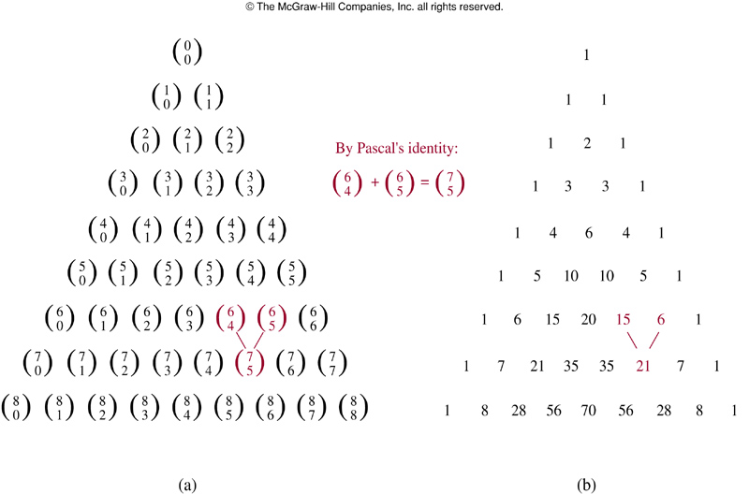
FIGURE 1 (5.4)
FIGURE 1 Pascal’s Triangle.
歐亞書局
P. 367
Notes:
p:\msoffice\My Projects\Rosen 6e 2007\Imagebank\JPEGs07-24-06\ch05\jpeg\05_4_01.jpg

Slide 50
Some Other Identities of the Binomial Coefficients
Theorem 3: (Vandermonde’s Identity) Let m, n, and r be nonnegative integers with r not exceeding either m or n. Then,
C(m+n, r)=Σ_{k=0..r}C(m,r-k)C(n,k).
  Proof
Corollary 4: If n is a nonnegative integer, then,
C(2n,n)=Σ_{k=0..n}C(n,k)²
  Proof
Theorem 4: Let n and r be nonnegative integers with r<=n. Then,
C(n+1,r+1)= Σ_{j=r..n}C(j,r).
  Proof

Slide 51
5.5 Generalized Permutations and Combinations
Permutations with repetition
  Theorem 1: The number of r-permutations of a set of n objects with repetition allowed is n^{r}.
  Ex.1
Combinations with repetition
  Theorem 2: There are C(n+r-1,r)=C(n+r-1,n-1) r-combinations from a set with n elements when repetition of elements is allowed.
  Ex.2-3
  Ex.4-6

Slide 52
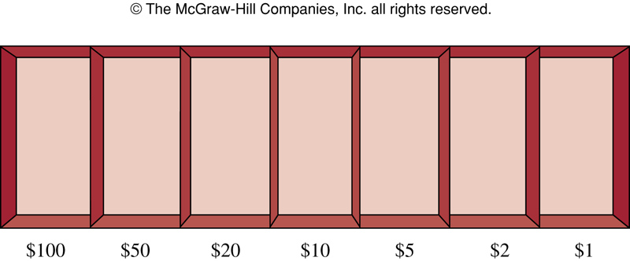
FIGURE 1 (5.5)
FIGURE 1 Cash Box with Seven Types of Bills.
歐亞書局
P. 372
Notes:
p:\msoffice\My Projects\Rosen 6e 2007\Imagebank\JPEGs07-24-06\ch05\jpeg\05_5_01.jpg

Slide 53
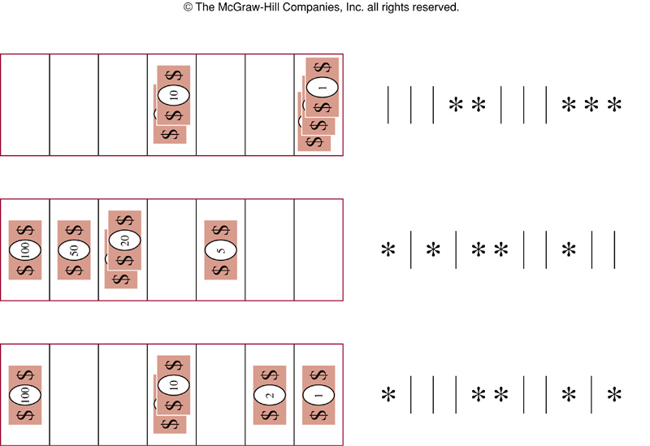
FIGURE 2 (5.5)
FIGURE 2 Examples of Ways to Select Five Bills.
歐亞書局
P. 372
Notes:
p:\msoffice\My Projects\Rosen 6e 2007\Imagebank\JPEGs07-24-06\ch05\jpeg\05_5_02.jpg

Slide 54
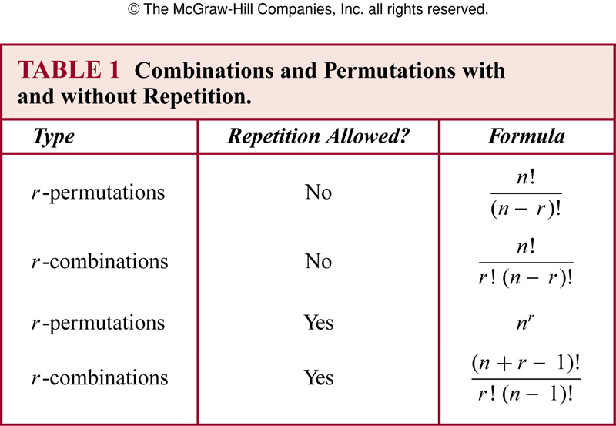
TABLE 1 (5.5)
歐亞書局
P. 375
Notes:
p:\msoffice\My Projects\Rosen 6e 2007\Imagebank\JPEGs07-24-06\ch05\jpeg\t05_5_01.jpg

Slide 55
Permutations with indistinguishable objects
  Theorem 3: The number of different permutations of n objects, where there are n1 indistinguishable objects of type 1, n2 indistinguishable objects of type 2, …, and nk indistinguishable objects of type k, is
  n!/(n1!n2!...nk!).
  Ex.7

Slide 56
Distributing objects into boxes
  Objects: distinguishable/indistinguishable
  Boxes: distinguishable/indistinguishable
Distinguishable objects and distinguishable boxes
  Ex.8
  Theorem 4: the number of ways to distribute n distinguishable objects into k distinguishable boxes so that ni objects are placed into box i, i=1, 2, …, k, equals
  n!/(n1!n2!...nk!).

Slide 57
Indistinguishable objects and distinguishable boxes
  The same as counting the number of n-combinations for a set with k elements when repetitions are allowed
    Ex.9
Distinguishable objects and indistinguishable boxes
  More difficult, no simple closed formula
  Ex.10

Slide 58
Indistinguishable objects and indistinguishable boxes
  No simple closed formula
  Ex.11
  The same as partitioning positive integer n into k positive integers.

Slide 59
5.6 Generating Permutations and Combinations
Generating permutations
  Lexicographic (dictionary) ordering
    Permutation a₁a₂…a_{n} precedes b₁b₂…b_{n}, if for some k, with 1<=k<=n, a₁=b₁, a₂=b₂, …, a_{k-1}=b_{k-1}, and a_{k}<b_{k}.
    Ex.1
    For a₁a₂…a_{j}a_{j+1}…a_{n} such that
    a_{j}<a_{j+1}
    a_{j+1}>a_{j+2}>…>a_{n}
      Find the smallest among a_{j+1}, …, a_{n} that is > a_{j}
      Increasing order for the remaining numbers
    Ex.2
    Ex.3

Slide 60
Algorithm 1: Generating the next permutation in lexicographic order
  Procedure next_permutation(a₁a₂…a_{n})
  j:=n-1
  while a_{j}>a_{j+1}
  j:=j-1
  k:=n
  while a_{j}>a_{k}
  k:=k-1
  interchange a_{j} and a_{k}
  r:=n
  s:=j+1
  while r>s
  begin
  interchange a_{r} and a_{s}
  r:=r-1
  s:=s+1
  end

Slide 61
Generating Combinations
  Correspondence with bit strings of length n
  Binary expansion of an integer between 0 and 2^{n}-1
  At each stage, the next binary expansion is found by locating the first position from the right that is not a 1, then changing all the 1s to the right of this position to 0s and making this first 0 a 1.
    Ex.4

Slide 62
Algorithm 2: Generating the next larger bit string
  Procedure next_bit_string(b_{n-1}b_{n-2}…b₁b₀)
  i:=0
  while b_{i}=1
  begin
  b_{i}:=0
  i:=i+1
  end

Slide 63
The r-combinations can be listed using lexicographic order on the sequence
  The next combinations after a₁a₂…a_{r} can be obtained by:
    Locate the last a_{i} such that a_{i}!=n-r+i
    Replace a_{i} with a_{i}+1, a_{j} with a_{i}+j-i+1, for j=i+1, …, r
    Ex.5

Slide 64
Algorithm 3: generating the next r-combination in lexicographic order
  Procedure next_r_comb(a₁a₂…a_{r})
  i:=r
  while a_{i}=n-r+i
  i:=i-1
  a_{i}:=a_{i}+1
  for j:=i+1 to r
  a_{j}:=a_{i}+j-i

Slide 65
Thanks for Your Attention!

